Slide 1
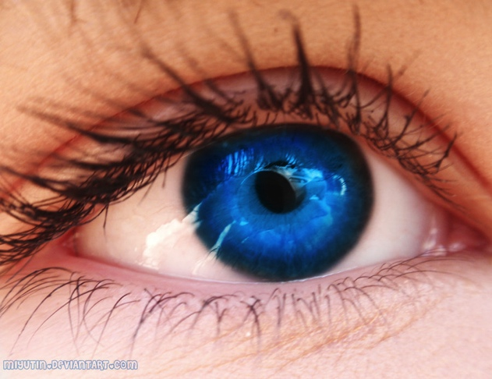
236860
Lecture 4
Digital Image Processing
Discrete domain signals & systems
Alex Bronstein

Slide 2







Sampling and periodization
Continuous
Discrete
$$f\left(x\right) x∈ℝ^{d}$$
Signal
Sampled on${ ℒ}^{∗}={A^{∗}ℤ}^{d}={A^{−T}ℤ}^{d}$
$$f\left(A^{∗}n\right)$$
Fourier transform
Periodized on$ℒ={Aℤ}^{d}$
$$F\left(ξ\right)$$
$$\tilde{F}\left(ξ\right)=\sum_{n∈ℤ^{d}}{F(ξ−An) }$$
$ℒ_{0}=A{\left[−\frac{1}{2},\frac{1}{2}\right]}^{d}$-periodic

Slide 3



Discrete domain Fourier transform
$$\tilde{F}\left(ξ\right)$$
is $A{\left[−\frac{1}{2},\frac{1}{2}\right]}^{d}$-periodic
Can be fully described by its content on $A{\left[−\frac{1}{2},\frac{1}{2}\right]}^{d}$
Normalized (a.k.a. digital) frequency ${ω∈\left[−\frac{1}{2},\frac{1}{2}\right]}^{d}$
Discrete-domain Fourier transform $F\left[ω\right]=vol ℒ⋅\tilde{F}\left(Aω\right)$

Slide 4








Discrete domain Fourier transform
$$F\left[ω\right]=vol ℒ⋅\tilde{F}\left(Aω\right)$$
$$= ({vol ℒ⋅III}_{ℒ}∗F)\left(Aω\right)$$
$$=\sum_{p∈ℒ^{∗}}{f(p){⋅ℱ(τ}_{p}δ)\left(Aω\right)}$$
$$=ℱ({III}_{ℒ^{∗}}⋅f)\left(Aω\right)$$
$$=\sum_{p∈ℒ^{∗}}{f\left(p\right)φ_{−p}\left(Aω\right)}$$
$$=\sum_{n∈ℤ^{d}}{f\left(A^{∗}n\right)e^{−2πi{\left(Aω\right)}^{T}A^{∗}n}}$$
$$=\sum_{n∈ℤ^{d}}{f\left(A^{∗}n\right)e^{−2πiω^{T}n}}$$
$$=\sum_{n∈ℤ^{d}}{f[n]e^{−2πiω^{T}n}}$$

Slide 5



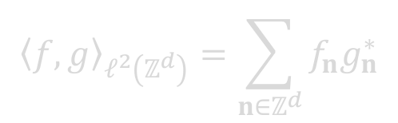


Discrete domain Fourier transform
Discrete-domain signal
$$f\left[n\right]=f(A^{∗}n)$$
$${\left\langle f,g\right\rangle }_{ℓ^{2}\left(ℤ^{d}\right)}=\sum_{n∈ℤ^{d}}{f_{n}g_{n}^{∗}}$$
Discrete-domain Fourier transform
$$=\sum_{n∈ℤ^{d}}{f[n]e^{−2πiω^{T}n}}$$
$$F\left[ω\right]=vol ℒ⋅\tilde{F}\left(Aω\right)$$
$$={\left\langle f,φ_{ω}\right\rangle }_{ℓ^{2}(ℤ^{d})}$$
Inverse Fourier transform
$$f\left[n\right]=\int_{{\left[−\frac{1}{2},\frac{1}{2}\right]}^{d}}{F[ω]}e^{2πiω^{T}n}dω$$
Properties inherited from continuous domain

Slide 6









Discrete domain systems
$f∈$ $ℒ_{0}$-band limited
$$g=h∗f$$
$g[n]$ sampled on $ℒ^{∗}$
$$\underset{↔}{ ℱ } vol ℒ⋅{III}_{ℒ}∗(F⋅H)$$
$${III}_{ℒ^{∗}}⋅g=$$
$${III}_{ℒ^{∗}}⋅(f∗h)$$
$$=({III}_{ℒ^{∗}}⋅f)∗({III}_{ℒ^{∗}}⋅h)$$
$$=vol ℒ⋅{(III}_{ℒ}∗F)⋅{(III}_{ℒ}∗H)$$

Slide 7







Discrete domain systems
$${III}_{ℒ^{∗}}⋅g=$$
$${III}_{ℒ^{∗}}⋅(f∗h)$$
$$=({III}_{ℒ^{∗}}⋅f)∗({III}_{ℒ^{∗}}⋅h)$$
$$=\left(\sum_{p∈ℒ^{∗}}{f\left(p\right)τ_{p}δ}\right)∗\left(\sum_{p∈ℒ^{∗}}{h\left(p\right)τ_{p}δ}\right)$$
$$=\sum_{p,q∈ℒ^{∗}}{f\left(p\right)h(q)τ_{p+q}δ}$$
$$=\sum_{s∈ℒ^{∗}}{\left(\sum_{q∈ℒ^{∗}}{f\left(p\right)h(s−p) }\right)τ_{s}δ}$$
$$s=p+q$$
$$=\sum_{m∈ℤ^{d}}{\left(\sum_{n∈ℤ^{d}}{f\left(A^{∗}n\right)h(A^{∗}(m−n)) }\right)τ_{A^{∗}m}δ}$$

Slide 8





Discrete domain systems
$$\sum_{m∈ℤ^{d}}{\left(\sum_{n∈ℤ^{d}}{f\left(A^{∗}n\right)h(A^{∗}(m−n)) }\right)τ_{A^{∗}m}δ}$$
$${III}_{ℒ^{∗}}⋅g=$$
$$=\sum_{m∈ℤ^{d}}{\left(\sum_{n∈ℤ^{d}}{f\left[n\right]h[m−n] }\right)τ_{A^{∗}m}δ}$$
$$=\sum_{m∈ℤ^{d}}{g[m]τ_{A^{∗}m}δ}$$
$$g\left[m\right]=\sum_{n∈ℤ^{d}}{f\left[n\right]h[m−n] }$$
$$=\left(f∗h\right)[m]$$
discrete convolution

Slide 9



Kroenecker’s delta
Continuous convolution:
$$f∗δ=f$$
Discrete convolution:
$$f∗δ=f$$
Kroenecker’s delta sequence
$$δ_{n}=\left\{\begin{matrix}1 & : n=0 \\ 0 & : n≠0\end{matrix}\right.$$

